Slide 1
Future of A.I.
Made by shubh
11B

Slide 2
In general
Artificial intelligence (AI) is transforming industries at an unprecedented pace. In fact, 72% of organizations use AI technology to improve at least one business function. From healthcare and finance to logistics and beyond, AI-driven solutions allow businesses to achieve next-level efficiency and laser-focused decision-making.
As the demand for AI professionals continues to grow, understanding the potential career paths in this growing field is critical for students looking for rewarding and in-demand careers. This presentation dives into of 5 artificial intelligence career paths and highlights the essential skills.

Slide 3
Data Scientist
Data is transforming the way business works globally. Businesses now have access to enormous amounts of data regarding sales, customer interactions, and digital experiences. This massive amount of data is expected to make businesses more data-driven.
Instead of relying on gut instinct, businesses integrate different systems to gain important insights to motivate action and drive innovation. Yet, the data doesn’t make sense on its own. A data scientist identifies the available data and determines how to use it to answer business questions effectively.
What does a Data Scientist do?:Data scientists combine statistics, machine learning, and computer science to turn data into actionable insights.

Slide 4
Computer Vision Engineer
A computer vision engineer is an expert who has a deep understanding of machine learning algorithms and neural networks that simulate human-like vision. The responsibility of a computer vision engineer is to develop and automate computer vision models that make work and life easier.
Computer vision engineers undertake a range of tasks to develop, deploy, and maintain these systems:
Design, test, and deploy computer vision algorithms and hardware tailored to diverse environments.
Develop automated vision algorithms, especially for applications involving robotics and autonomous systems.
Analyze and optimize analytics from computer vision algorithms to enhance their efficiency and performance.
Innovate and propose practical solutions to real-world problems through creative problem-solving.

Slide 5
Robotics Engineer
The robotics engineering field falls under electrical, mechanical, and computer engineering. It involves designing, building, and engineering robots. It’s also a practical design role in the research field.
As a robotics engineer, you may develop robotic applications across many industries, including automotive, aerospace, manufacturing, defense, and medicine.
Working as a robotics engineer, you can specialize in areas such as:
Mobility locomotion
Sensing and perception
Operator interface
Manipulators and effectors
Programming

Slide 6
Machine Learning Engineer
Machine Learning Engineers are technically proficient programmers who research, build, and design self-running software to automate predictive models. An ML Engineer builds artificial intelligence (AI) systems that leverage huge data sets to generate and develop algorithms capable of learning and eventually making predictions.
Designing machine learning systems requires that the Machine Learning Engineer assess, analyze, and organize data, execute tests, and optimize the learning process to help develop high-performance machine learning models.
Overall, this role is responsible for designing machine learning systems, which involves assessing and organizing data, executing tests and experiments, and generally monitoring and optimizing machine learning processes to help develop strong performing machine learning systems.
Many job descriptions call for knowledge of programming languages like Python, Java, and C/C++.

Slide 7
Business Intelligence Developers
The role of the business intelligence developer is to design solutions for data research and visualization. Let’s dig deeper into what a business intelligence developer is and how you can make this your career.
Business intelligence developers translate real-world business requirements of their clients or employers into well-designed technical solutions. They work with data engineers to meet these requirements from the data source to the end user. Business intelligence tools created by developers may include:
Data warehouses
Data visualization
Data dashboards
Data models
The work done by business intelligence developers reinforces good data practices in their workplaces. A 2024 BARC report identified the most important data management trends in the global market. They keep their organizations ahead of trends in areas like:Data security & privacy, Data quality management, Data governance, Data-driven culture, Data literacy

Slide 8
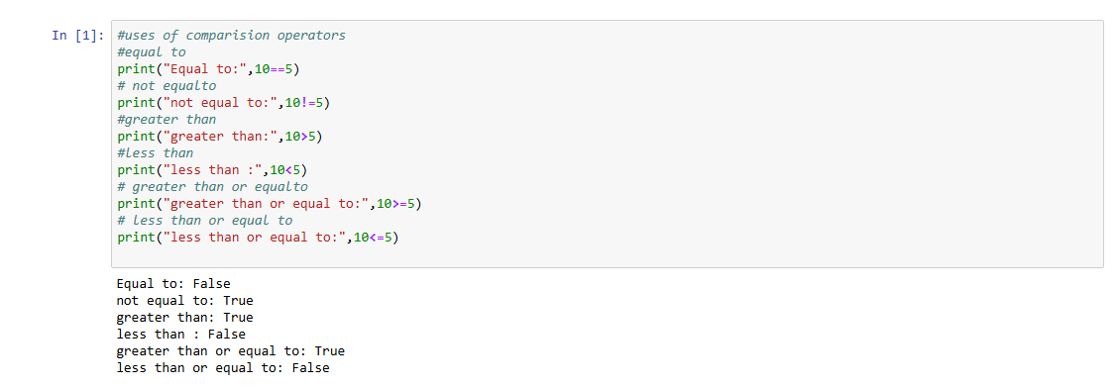

Slide 9


Slide 10


Slide 11


